Slide 1

SREENIVASA INSTITUTE OF TECHNOLOGY AND MANAGEMENT STUDIES (Autonomous) DEPARTMENT OF COMPUTER SCIENCE AND ENGINEERING
INTRUSION DETECTION SYSTEM USING PCA WITH MACHINE LEARNING CLASSIFIERS
PRESENTEDED BY:
N Balakrishna [19751A0577 ]
N Kiran [19751A0578 ]
N Siva nagireddy [19751A0579 ]
S Durga prasad [19751A0599]
GUIDED BY:
Mr . VIJAYA KUMAR , M.E,M.B.A
Assistant Professor,
Department Of CSE .

Slide 2
INDEX
Abstract
Introduction
Literature review
Existing Method
Proposed Method
Hardware and Software Requirements
Architecture Diagram
Module Description
Implementation
Result
References

Slide 3
ABSTRACT
We developed a Network Intrusion Detection System (NIDS), which uses a suite of machine learning techniques to automatically detect attacks against computer networks and systems.
It uses an approach to develop efficient NIDS by using the principal component analysis (PCA) along with different classification algorithms like Support Vector Machines, Random Forest and XgBoost.
The purpose of an intrusion detection system is to detect attacks. However, it is equally important to detect attacks at an early stage in order to minimize their impact

Slide 4
INTRODUCTION
In the 21st century the development of telecommunications networks has taken giant leaps from circuit and packet switched networks towards all-IP based networks.
This development has created a unified environment where communication of applications and services (data and voice) are being transferred on top of the IP-protocol.
Different attacks are seen on the system or the network. The attacks like a black hole, grey hole, wormhole etc. are seen on the network system. These attacks are to steal the information from the system.
So to prevent the system from such attacks, the intrusion detection system was introduced. IDS keep track of attacks on the system and to prevent the system from these attacks.

Slide 5
LITERATURE REVIEW
[1] S. Waskle, L. Parashar and U. Singh, "Intrusion Detection System Using PCA with Random Forest Approach," 2020 International Conference on Electronics and Sustainable Communication Systems (ICESC), 2020.
This journal discusses about intrusion classification using random forest and PCA.
This paper has proposed an approach to develop efficient IDS by using the principal component analysis (PCA) and the random forest classification algorithm. Where the PCA will help to organise the dataset by reducing the dimensionality of the dataset and the random forest will help in classification. Results obtained states that the proposed approach works more efficiently in terms of accuracy as compared to other techniques like SVM, Naive Bayes, and Decision Tree.

Slide 6
[2] K. Park, Y. Song and Y. Cheong, "Classification of Attack Types for Intrusion Detection Systems Using a Machine Learning Algorithm," 2018 IEEE Fourth International Conference on Big Data Computing Service and Applications (BigDataService), 2018
This paper explores different scenarios of machine learning implementation for type of intrusion classification.
In this paper, they presented the results of experiments to evaluate the performance of detecting different types of attacks (e.g., IDS, Malware, and Shellcode). We analyze the recognition performance by applying the Random Forest algorithm to the various datasets

Slide 7
[3] A. Tesfahun and D. L. Bhaskari, "Intrusion Detection Using Random Forests Classifier with SMOTE and Feature Reduction," 2019 International Conference on Cloud & Ubiquitous Computing & Emerging Technologies, 2019.
It discusses about intrusion detection with oversampling of data before implementing machine learning models.
Shows that Random Forest classifier with SMOTE and information gain based feature selection gives better performance in designing IDS that is efficient and effective for network intrusion detection.

Slide 8
EXISTING METHOD
In existing system, models are build based on manual detections or rule based detections. It requires enormous costs and high number of skilled people to detect such frauds. The worst part of them is that the intrusions are most likely to get detected once the attack is happening instead of earlier to take action.
DISADVANTAGES:
Low accuracy.
High expensive
Time consuming.
High complexities

Slide 9
PROPOSED METHOD
We propose this system which uses Machine Learning Algorithms like SVM, Random Forest and Xg Boost for intrusion detections. These techniques can determine the possibility of an attack faster than the existing methods hence enabling faster response to the threat . Principal Component Analysis is used for reducing the high cardinality in this system.
ADVANTAGES:
1) High accuracy. 4) Inexpensive
2) Time Saving. 5)Easy to scale
3)Low complexity

Slide 10
SOFTWARE & HARDWARE REQUIREMENTS
Python v3.6+
PyCharm IDE.
RAM: 4GB minimum.
Processor: Intel I3 (min)
Hard Disk: 128 GB +
OS: Windows 7+
Libraries: pandas, numpy, scikit-learn, xgboost.

Slide 11
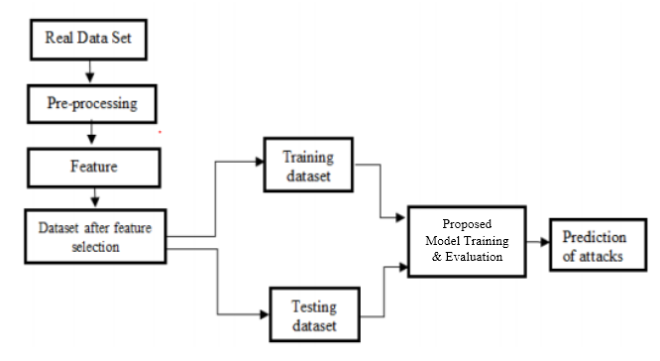
ARCHITECTURE DIAGRAM

Slide 12
Step by Step process of working:
Step1: Data Collection
The first step in building an IDS is to collect data, which typically includes network traffic logs, system logs, and application logs. The data is usually in a large and unstructured format.
Step2: Data Preprocessing
The collected data is preprocessed to extract relevant features from the raw data. In this step, irrelevant data is filtered out, and the remaining data is normalized, scaled, and formatted.
Step3: Dimensionality Reduction with PCA
Since the collected data is usually high dimensional, PCA is applied to reduce the dimensionality of the data. PCA is a technique that reduces the dimensionality of the data by transforming it into a lower dimensional space, while retaining the most important information.

Slide 13
.
Step4: Splitting data
The reduced data is then split into training and testing sets. The training set is used to train the machine learning models, while the testing set is used to evaluate the performance of the models . Model training with SVM, Xg Boost, and Random Forest: The reduced data is fed into three different machine learning algorithms, SVM, Xg Boost, and Random Forest, to train three separate models.
Here are the steps involved in randomly splitting data into training and testing sets:
a) Shuffle the dataset : Before splitting the data, shuffle the dataset to ensure that the data points are in random order. This step is essential to prevent any underlying patterns or biases in the data from influencing the split.
b) Define the split ratio : Determine the proportion of the dataset that should be allocated to the training set and the testing set. Typically, the split ratio is around 80:20 or 70:30, with the majority of the data being used for training.

Slide 14
.
c)Split the data : Using the split ratio, divide the shuffled dataset into two parts: the training set and the testing set. The training set should contain the majority of the data, and the testing set should contain the remainder.
d)Maintain class distribution : When splitting the data, ensure that the distribution of classes in the training and testing sets is similar to the distribution in the original dataset. This step is important to ensure that the model learns to generalize to new data and doesn't overfit on a particular class.
e)Cross-validation : In addition to random splitting, cross-validation is another technique used to split the data into multiple subsets for training and testing. Cross-validation involves splitting the data into multiple folds and iteratively training and testing the model on different subsets of the data to obtain a more robust estimate of the model's performance

Slide 15
.
Step5:Model evaluation
Once the models are trained, they are evaluated on the testing set to determine their performance in detecting intrusions. The evaluation metrics commonly used are accuracy, precision, recall, and F1 score.
Step6:Model comparison
The performance of the three models is compared to select the best-performing model. The model with the highest performance metrics is selected for deployment in the production environment.
Step7:Deployment
Once the best model is selected, it is deployed in the production environment for real-time intrusion detection.

Slide 16
COMPONENT DIAGRAM
A component diagram, also known as a UML component diagram, describes the organization and wiring of the physical components in a system. Component diagrams are often drawn to help model implementation details and double-check that every aspect of the system's required functions is covered by planned development.

Slide 17
SEQUENCE DIAGRAM:
A sequence diagram in Unified Modeling Language (UML) is a kind of interaction diagram that shows how processes operate with one another and in what order. It is a construct of a Message Sequence Chart. Sequence diagrams are sometimes called event diagrams, event scenarios, and timing diagrams.

Slide 19
MODULE DESCRIPTION
SYSTEM:
Stores Data
Model Training
Model Predictions
USER:
Load Dataset
View Dataset.
Select Model.
Evaluation

Slide 20
ALGORITHMS
Random Forest:
Random forests or random decision forests are an ensemble learning method for classification, regression and other tasks that operate by constructing a multitude of decision trees at training time and outputting the class that is the mode of the classes (classification) or mean/average prediction (regression) of the individual trees.
Random decision forests correct for decision trees' habit of over fitting to their training set.
Random forests generally outperform decision trees, but their accuracy is lower than gradient boosted trees. However, data characteristics can affect their performance.

Slide 21
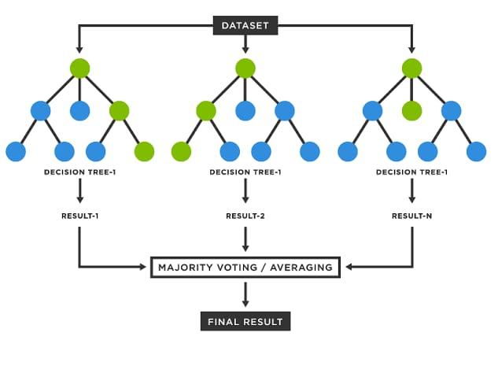

Slide 22
Support Vector Machine:
The objective of the support vector machine algorithm is to find a hyperplane in an N-dimensional space (N- the number of features) that distinctly classifies the data points.
Support Vector Machine, abbreviated as SVM can be used for both regression and classification tasks. But, it is widely used in classification objectives.
Hyperplanes are decision boundaries that help classify the data points. Data points falling on either side of the hyperplane can be attributed to different classes.

Slide 23
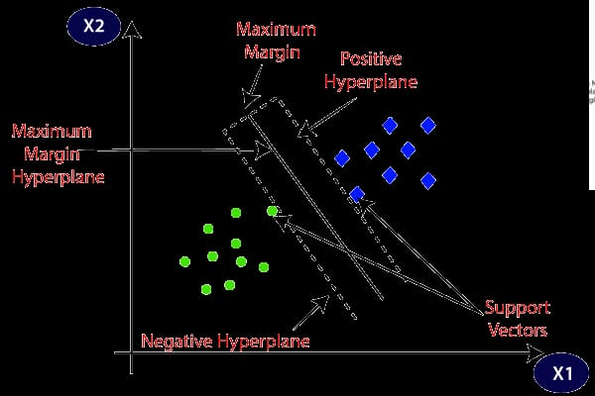

Slide 24
XgBoost:
XGBoost is a decision-tree-based ensemble Machine Learning algorithm that uses a gradient boosting framework.
The implementation of the model supports the features of the scikit-learn and R implementations, with new additions like regularization. Three main forms of gradient boosting are supported:
.

Slide 25
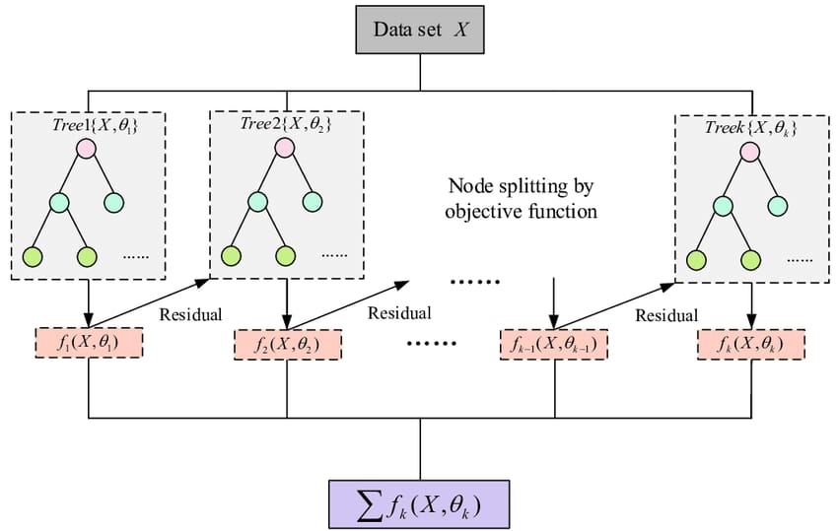

Slide 26
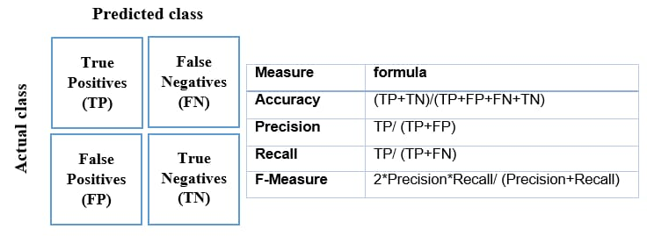
ACCURACY

Slide 27
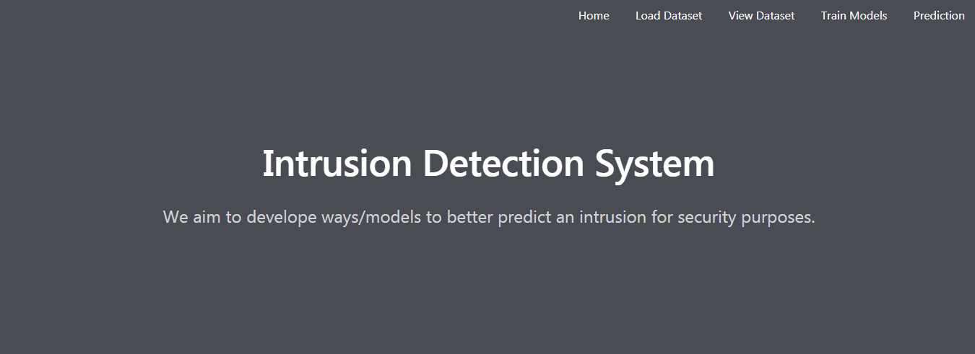
IMPLEMENTATION
Home :

Slide 28
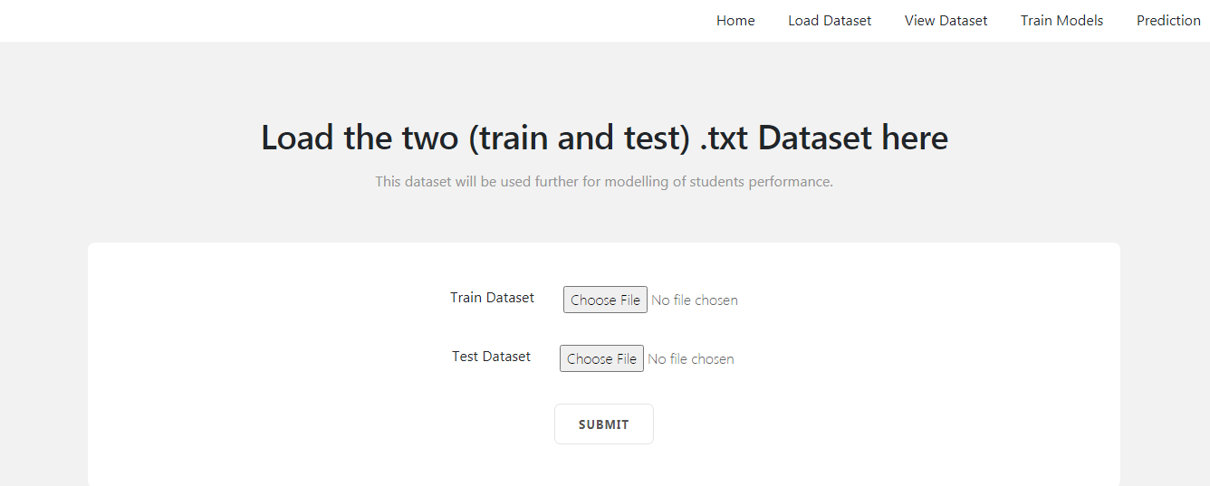
LOAD DATA PAGE:

Slide 29
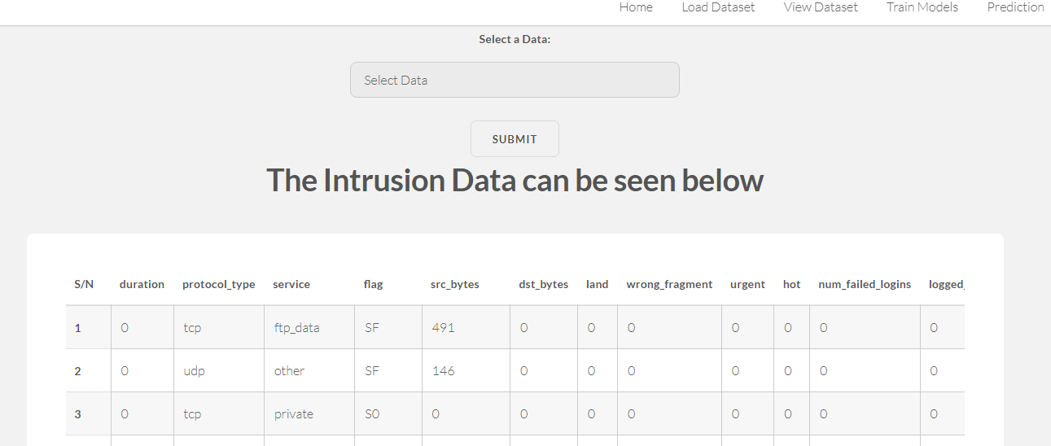
VIEW DATA :

Slide 30
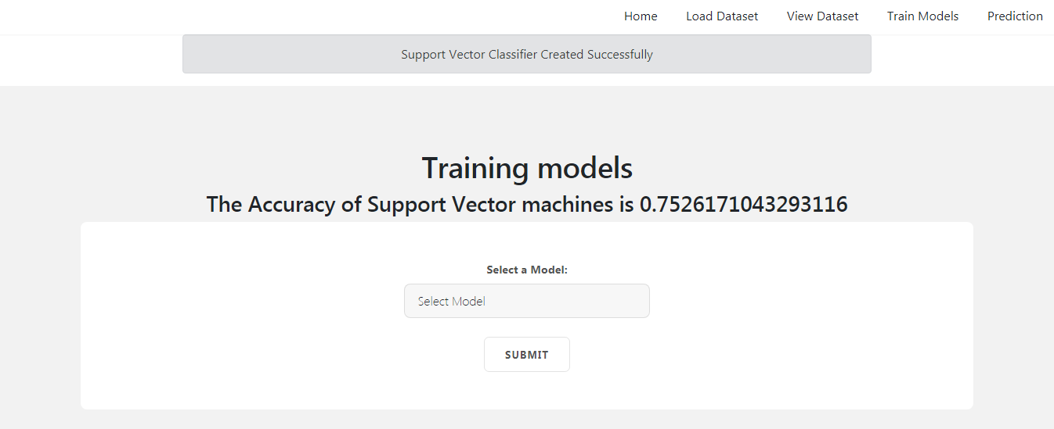
MODEL TRAINING :

Slide 31
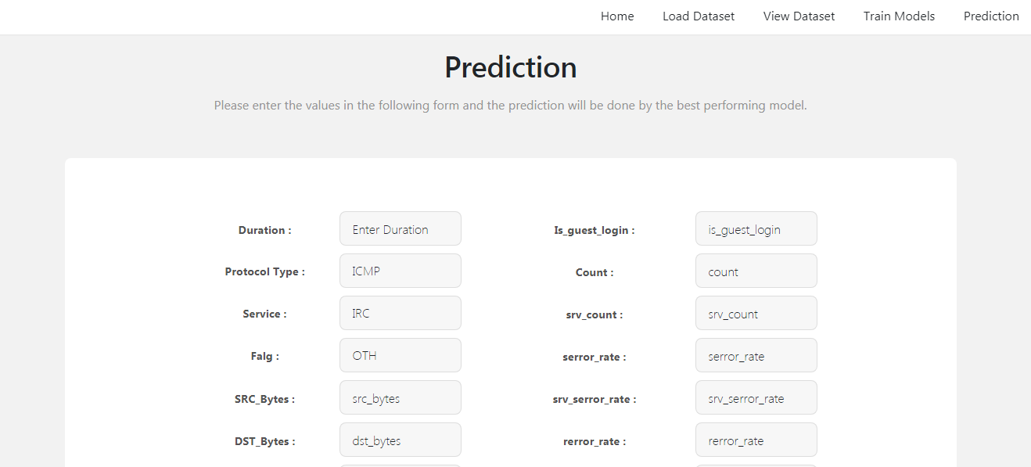
PREDICTION PAGE :

Slide 32
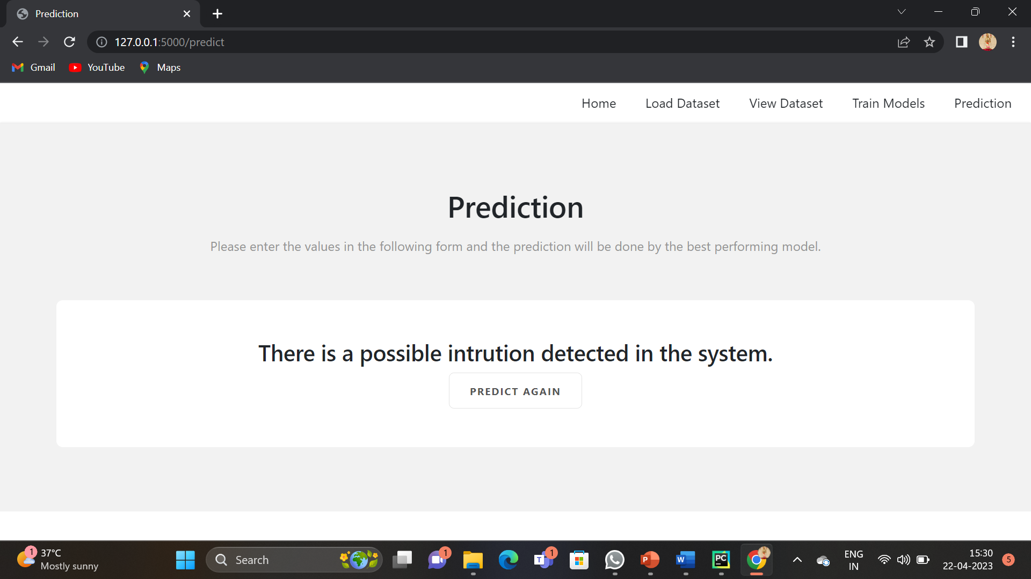
RESULT

Slide 33
REFERENCES
[1] Jafar Abo Nada; Mohammad Rasmi Al-Mosa, 2021 International Arab Conference on Information Technology (ACIT), A Proposed Wireless Intrusion Detection Prevention and Attack System.
[2] Kinam Park; Youngrok Song; Yun-Gyung Cheong, 2020 IEEE Fourth International Conference on Big Data Computing Service and Applications (BigDataService), Classification of Attack Types for Intrusion Detection Systems Using a Machine Learning Algorithm
[3] S. Bernard, L. Heutte and S. Adam “On the Selection of Decision Trees in Random Forests” Proceedings of International Joint Conference on Neural Networks, Atlanta, Georgia, USA, June 14-19, 2019, 978-1-4244-3553- 1/09/$25.00 ©2019 IEEE

Slide 34
REFERENCES
[4] A. Tesfahun, D. Lalitha Bhaskari, ” Intrusion Detection using Random Forests Classifier with SMOTE and Feature Reduction” 2018 International Conference on Cloud & Ubiquitous Computing & Emerging Technologies, 978-0- 4799-2235-2/13 $26.00 © 2018 IEEE
[5] Le, T.-T.-H., Kang, H., & Kim, H. (2019).The Impact of PCA-Scale Improving GRU Performance for Intrusion Detection. 2019 International Conference on Platform Technology and Service (PlatCon). Doi:10.1109/platcon.2019.8668960
[6] Anish Halimaa A, Dr K.Sundarakantham: Proceedings of the Third International Conference on Trends in Electronics and Informatics (ICOEI 2019) 978-1-5386-9439-8/19/$31.00 ©2019 IEEE “MACHINE LEARNING BASED INTRUSION DETECTION SYSTEM.”

Slide 35
Thank You

